Slide 1
ANALYSIS OF HOUSE PRICES
Swathi Das

Slide 2
INTRODUCTION
Our investment bank wants to understand factors that are driving home prices and identify properties that are good investments.
Objective
Determine key factors that impact sale price for homes and develop recommendations for mortgage-backed security investments.

Slide 3
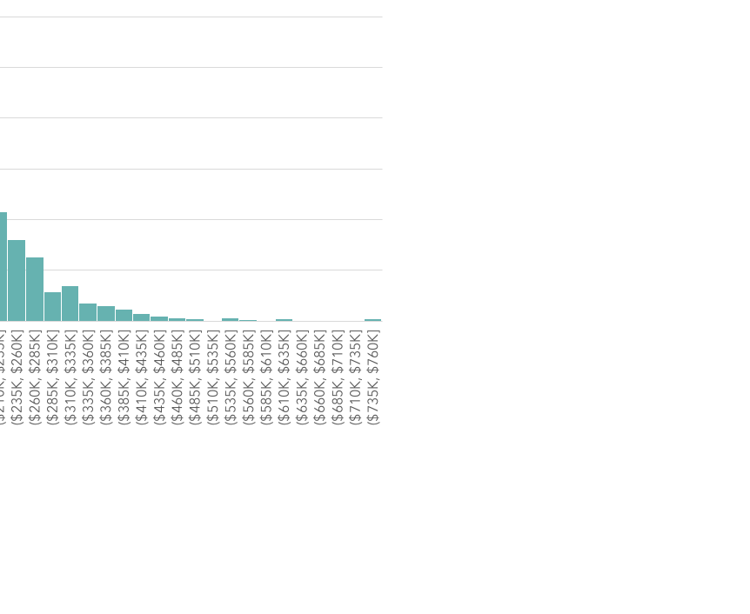
OVERVIEW
1460 Property from Ames, Iowa
Houses sold between 2006 to 2010
Range Sale Price – $35K-$755K
Average Sale Price - $181K
Normal Distribution with a slight right skew
Raw Data Source
Notes:
3 outliers but keeping them in.
Normal distribution with a slight slight positive skew
Ames, Iowa
What population are we inferring back to? Comparable midwestern cities

Slide 4

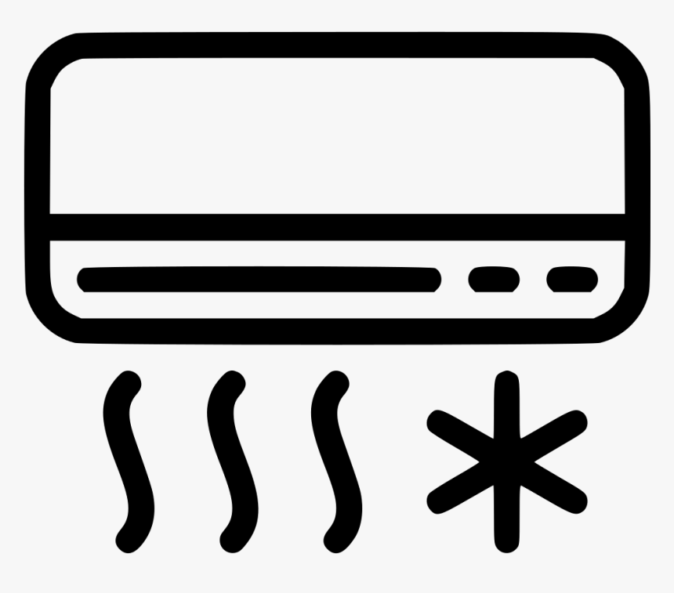
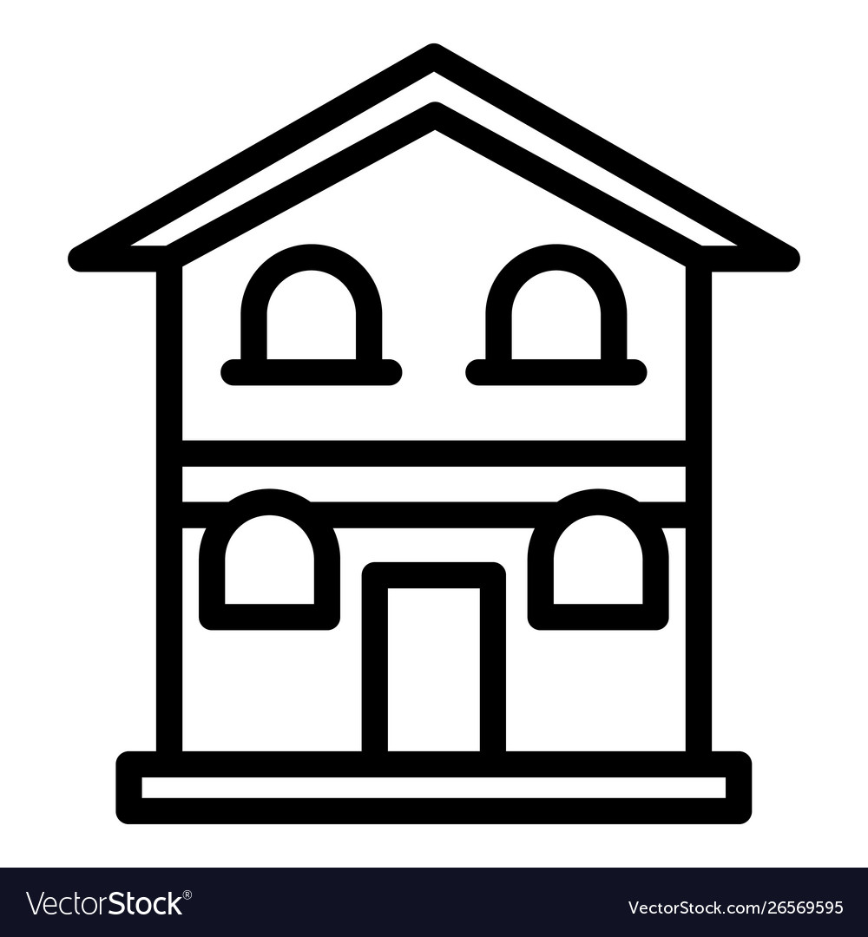
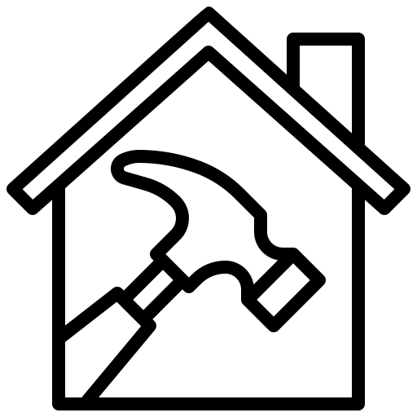

FACTORS ANALYZED
Overall Quality
Central Air
1 Story vs. 2 Story
Remodeled
Year Built

Slide 5
OVERALL QUALITY
Hypothesis
Houses with Overall Quality (material and finish of the house) Rated Above Very Good (>=8) have a different Sales Price than the Overall Quality Rated Good or Below (<8).
Null: Ho: μ1 - μ2 = 0
Alternative: Ha: μ1 - μ2 ≠ 0
Results
Mean >=8: 305K <8: 158K
Sample Size >=8: 229 <8: 1231
P-value: 7.967 ×10⁻⁶⁴
Interpretation
We reject Ho (null hypothesis) as the data provides convincing evidence to suggest Ho is wrong. The difference between the Overall Quality >=8 and Overall Quality <8 is statistically significant, using a significance level of 0.05.
With 95% confidence, the difference is between Sale Price lies between $135K and $160K.
Notes:
My hypothesis is that houses with OQ above very good has a different sales price than houses with OQ below good.
With a sample size of 229, houses rated higher than very good have a average sale price of 305K.
The houses rated below good has a sample size of 1231 and a average of 158K.
Margin of error >=8: $12K <8: $3K
10 - Very Excellent; 9 - Excellent; 8 - Very Good; 7 - Good; 6 - Above Average 5 - Average; 4 - Below Average; 3 - Fair; 2 - Poor; 1 - Very Poor

Slide 6
CENTRAL AIR
Hypothesis
Houses with Central Air have a different Sales Price than the Houses without Central Air.
Null: Ho: μ1 - μ2 = 0
Alternative: Ha: μ1 - μ2 ≠ 0
Results
Mean Central Air: 186K No: 105K
Sample Size Central Air: 1365 No: 95
P-value: 2.203 ×10⁻³⁷
Interpretation
We reject Ho (null hypothesis) as the data provides convincing evidence to suggest Ho is wrong. The difference between the Houses with Central Air and the Houses without Central Air is statistically significant, using a significance level of 0.05.
With 95% confidence, the difference is between Sale Price lies between $72K and $90K.
Notes:
My hypothesis is that houses with CA have a different sales price than houses without CA.
With a sample size of 1365, houses with CA have a average sale price of 186K.
The houses with CA have a sample size of 95 and a average sale price of 105K.
Margin of error Central Air: $4K No: $8K

Slide 7
HOUSE STYLE
Hypothesis
1 Story Houses have a different Price per Lot Area in sq ft than 2 Story Houses.
Null: Ho: μ1 - μ2 = 0
Alternative: Ha: μ1 - μ2 ≠ 0
Results
Mean 1 Story: $0.07 2 Story:$0.05
Sample Size 1 Story: 726 2 Story: 445
P-value: 5.161 ×10⁻¹²
Interpretation
We reject Ho (null hypothesis) as the data provides convincing evidence to suggest Ho is wrong. The difference between the Houses with 1 Story and 2 Story is significant, using a significance level of 0.05.
With 95% confidence, the difference in price per Lot Area (sq ft) lies between $0.0109 and $0.0193.
Notes:
My hypothesis is that houses with 1 Story have a different price per lot area (sqft) than houses with 2 Stories.
With a sample size of 726, houses with 1 story have an average price of 7 cents per lot area.
The houses with 2 stories have a sample size of 445 and an average price of 5 cents per lot area.
Margin of error 1 Story: $0.0031 2 Story: $0.0029

Slide 8
HOUSE STYLE PT. 2
Hypothesis
1 Story Houses have a different Sales Price than 2 Story Houses (Price per Lot Area in sq ft).
Null: Ho: μ1 - μ2 = 0
Alternative: Ha: μ1 - μ2 ≠ 0
Results
Mean 1 Story: $176K 2 Story:$210K
Sample Size 1 Story: 726 2 Story: 445
P-value: 2.399 ×10⁻¹¹
Interpretation
We reject Ho (null hypothesis) as the data provides convincing evidence to suggest Ho is wrong. The difference between the Houses with 1 Story and 2 Story is significant, using a significance level of 0.05.
With 95% confidence, the difference in sale price lies between $24K and $44K.
Notes:
My hypothesis is that houses with 1 story have a different sales price than houses with 2 stories.
With a sample size of 726, houses with 1 story has an average sale price of 176K.
The houses with 2 stories have a sample size of 445 and an average sale price of 210K.
Margin of error 1 Story: $6K 2 Story: $8K

Slide 9
REMODELED
Hypothesis
Remodeled houses have a different Sale Price than houses that were not remodeled.
Null: Ho: μ1 - μ2 = 0
Alternative: Ha: μ1 - μ2 ≠ 0
Results
Mean Remodel: $183K Not: $179K
Sample Size Remodel: 764 Not: 696
P-value: 0.407
Interpretation
The p-value of 0.407 is greater than our alpha of 0.05, which tells us that it is likely to observe as extreme of a difference as we are seeing if Ho is true.
We fail to reject Ho (null hypothesis) as the data does not provide sufficient evidence to suggest Ho is wrong.
Notes:
My hypothesis is that remodeled houses have a different sales price than houses that were not remodeled.
With a sample size of 764, remodeled houses have an average sale price of 183K.
The houses which were not remodeled have a sample size of 696 and an average sale price of 179K.
Margin of error Remodel: $5K Not: $7K

Slide 10
YEAR BUILT
Hypothesis
Houses built after 1980 (Post-Modern Houses) have a different Sales Price than Houses built before 1980.
Null: Ho: μ1 - μ2 = 0
Alternative: Ha: μ1 - μ2 ≠ 0
Results
Mean >1980: $233K < 1980: $143K
Sample Size >1980: 612 < 1980: 848
P-value: 5.885 ×10⁻⁹⁸
Interpretation
We reject Ho (null hypothesis) as the data provides convincing evidence to suggest Ho is wrong. The difference between the Houses Built before 1980 and Houses Built after 1980 is significant, using a significance level of 0.05
With 95% confidence, the difference is between Sale Price lies between $83K and $98K.
Notes:
My hypothesis is that houses built after 1980 have a different sales price than houses built before 1980.
With a sample size of 612, post modern houses have an average sale price of 233K.
The houses built before 1980 have a sample size of 848 and an average sale price of 143K.
Margin of error >1980: $7K < 1980: $3K

Slide 11
RECOMMENDATIONS
Overall Quality
There is a significant difference in sale prices with overall quality where houses with rating >=8 have a higher average sale price. People are buying houses that may not need any additional work done.
Central Air
There is a significant difference in sale prices with houses with central air having a higher average sale price. Signs that people want to buy houses with better amenities.
1 Story vs. 2 Story
There is a statistically significant difference in prices where houses with 1 story have a higher average price per square foot. There is further analysis data showing that 2 Story houses have a higher average sale price. This implicates that 1 story houses can be sold for more per square foot, but people rather buy houses with an additional story.
Remodeled
There is no significant difference on houses that are remodeled or not. This suggests that this is a factor that people may not consider.
Year Built
There is a significant difference in sale prices with houses being built after 1980 indicating that post modern buildings are in demand.

Slide 12
CALL TO ACTION
Our investment bank should invest in homes that have overall quality of 8 and up, central air, and built after 1980.
Our bank will save money by not spending more on fixing houses that need improvements.
When considering 1 story vs 2 story houses , we should target 2 story houses for smaller lot sizes and 1 story houses with larger lot area per square footage.

Slide 13
THANK YOU!
Questions?

